Slide 1
ELECTRONIC DEVICES
COURSE INSTRUCTOR:
UMANG RAJ PANDEY

Slide 2
PN junction,Depletion layers and Barrier Potential
P type semiconductors have holes as majority carriers while N type has electrons as majority carriers.
When a layer of P type material is placed next to N type material a PN junction is formed.
Holes from P side diffuse to N side and electrons from N side diffuse to P side due to density gradient. This process is called diffusion.

Slide 3
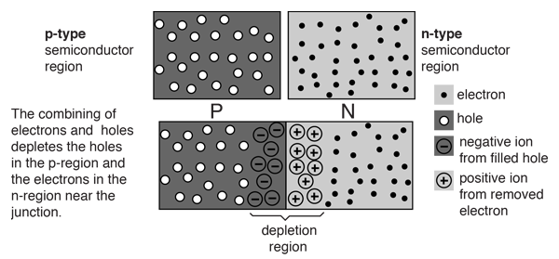

Slide 4
Free electrons crossing the junction creates negative ions in P side and positive ions in N side across the junction.This movement of electrons and holes occurs until an equilibrium is established.
At equilibrium, negative ions layer at P side repels the electrons and prevents electrons from crossing the junction from N side to P side.
Similarly,positive ions layer from P side prevents holes to cross the junction to N side, thus diffusion of charge carriers creates a barrier potential across the junction.
There are no free electrons and holes i.e. the region is depleted of mobile charges so this region is called depletion region or space charge region or transition region.
The magnitude of barrier potential is 0.3V for Germanium and 0.7V for Silicon.

Slide 5
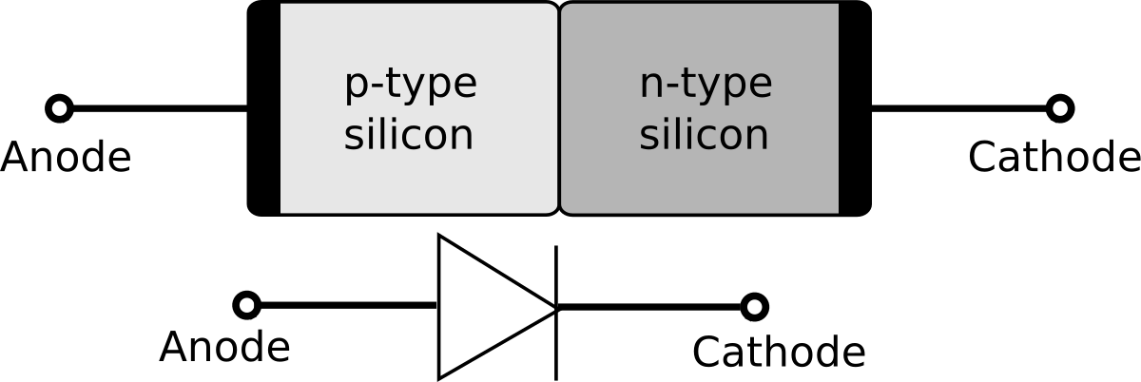
The PN Junction as a diode
The semiconductor diode formed simply by joining N type and P type material together is called PN junction diode.
This diode allows current in only one direction i.e. when it is forward biased.

Slide 6
Biasing of PN junction diode
Biasing is the process of connecting the diode terminals with the source terminals.
It can be done by two ways:
a) Forward biasing
b) Reverse biasing

Slide 7
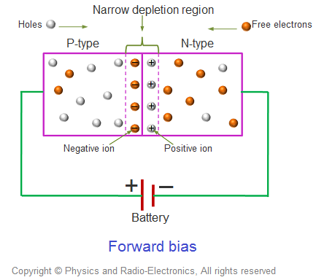
Forward Biasing

Slide 8
If the positive terminal of the battery is connected to P type material and negative terminal is connected to N type material the connection is called forward biasing.
The negative terminal of battery flows electrons on N region.These electrons repels the electrons on N region towards depletion region.
In P region these electrons recombines with holes but due to attraction of positive terminal of battery these electrons move towards positive terminal through holes.
Finally electrons reach to the cell.The cell again pumps electrons to N region and the process continues so we can conclude that current flows through diode during forward biased condition.

Slide 9
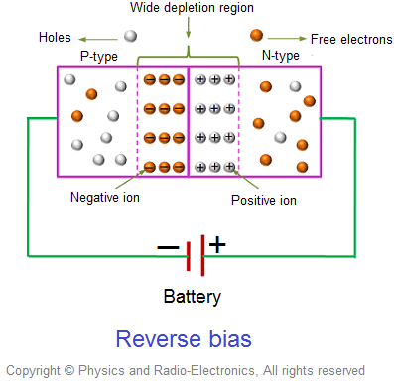
Reverse Biasing

Slide 10
If the P type material is connected to negative terminal of the battery and N type material is connected to positive terminal of battery it is called reverse biasing of diode.
During reverse biased condition,electrons on N region are attracted towards positive terminal of the battery and holes on P region are attracted towards negative terminal of the battery.This causes widening of depletion layer.
Since no charge carriers are crossing depletion layer,there is no current on reverse biased condition due to majority charge carriers but small current flows during reverse biased condition due to minority charge carriers.

